Slide 1
Modeling of granular materials

Slide 2


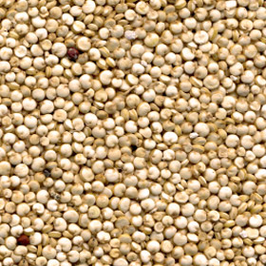
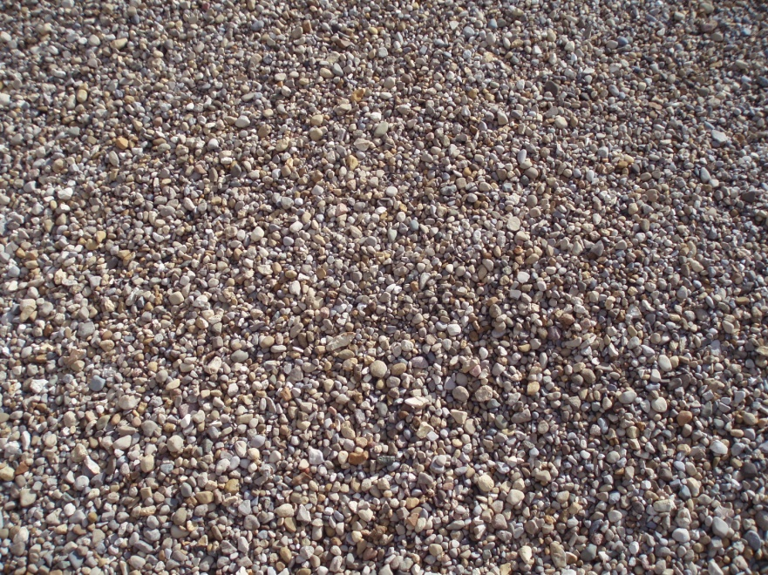
Granular materials
Sand
Powder
Cereals grains
Gravel

Slide 3
Physical behaviour
Free dispersion in free fall – no cohesion
Dry grains apply no/negligible attractive forces
Settle in stable piles
Height of pile – depends on friction coeff.
Flow plastically under pressure
decided based on yield criterion
Notes:
Yield criteria violated – flow plastically

Slide 4
Motivation

Slide 5
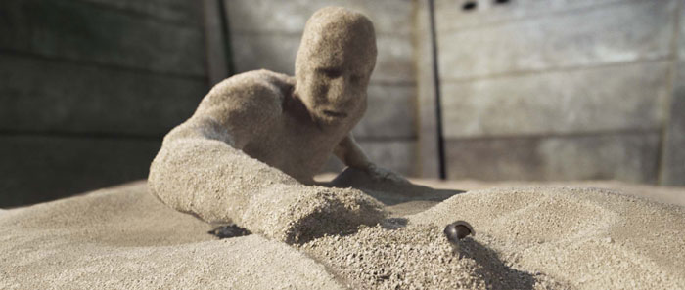

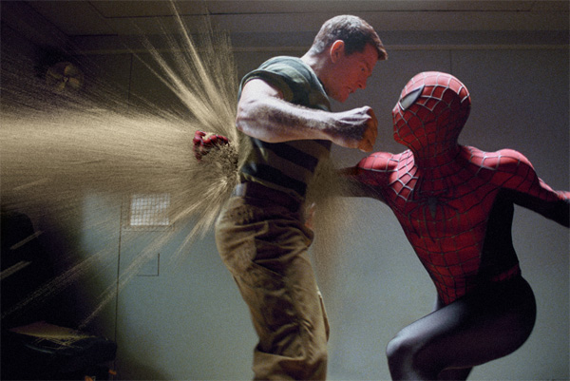
Movies and special effects
http://www.youtube.com/watch?v=shfLYWs-_QY&feature=channel
Notes:
Movies and special effects

Slide 6
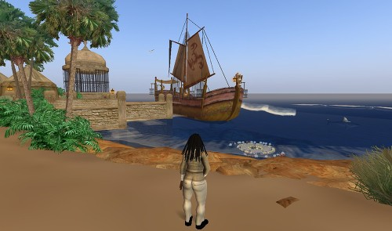
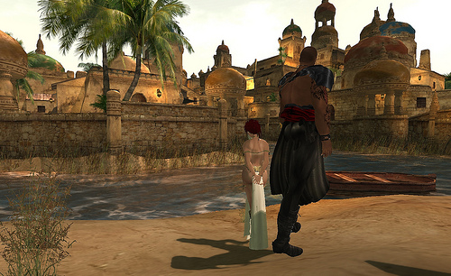
Virtual world (Second Life)

Slide 7


Games (Prince of Persia : Sands of Time)

Slide 8
The Problem
Behavioral aspects
Behavior is not exactly like solids, liquids or gases
No cohesion
Friction forces (inter-grain, boundaries)
Closely coupled with hydrostatic pressure and stress
Friction – transmit forces over long distances
E.g. Sand piles remain stable
Emergent behavior
Inelastic collisions

Slide 9
The Problem
Simulation issues
Scale ( > 10M grains )
Behavioral complexity
Non-linear constraints ( yielding stress )
Representation ( discrete, continuum )

Slide 10
Approaches
Particle-based
Surface flow
Fluid simulation
Continuum approach

Slide 11
Approaches
Particle-based
Surface flow
Fluid simulation
Continuum approach

Slide 12
Particle-based approach
Per-particle simulation
Accurate but slow
~100K particles possible (for ~1 min/frame)
Particle system → damped springs [Luciani et al. 1995]

Slide 13
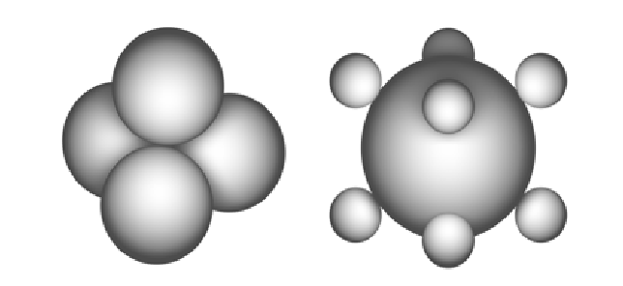
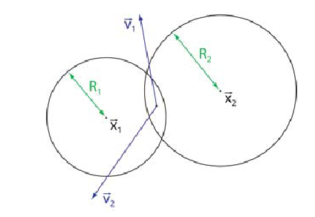
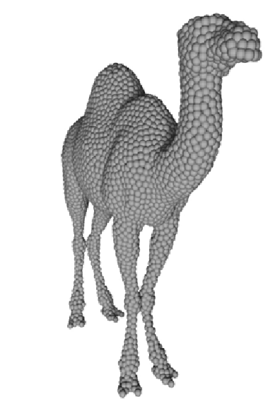
Particle-based approach
[Bell et al. 2005]
Molecular dynamics based contact model
grains as discrete particles
collection spheres → interlocking allows static friction
Compelling behavior using physical model
contact, normal and shear forces
Two-way coupling with rigid bodies
surface of rigid bodes → covered with spheres

Slide 14
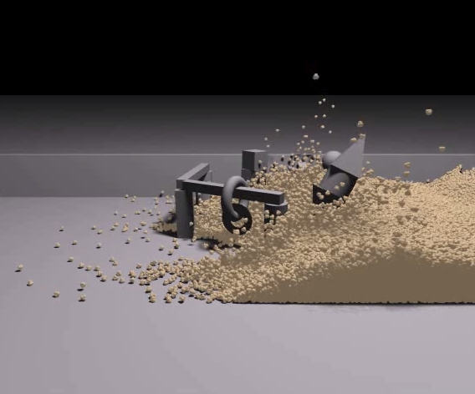
Video [Bell et al. 2005]

Slide 15
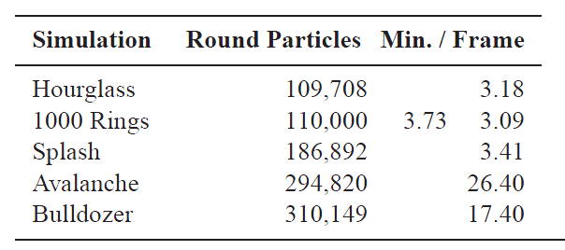
Limitation
high computational cost,
3-25 mins per frame
Neglects cohesion
cannot simulate moist sand
Fluid-grain coupling
Coarse grains
[Alduan et al 2009] - Interpolate coarse grains over fine grains

Slide 16
Approaches
Particle-based
Surface flow
Fluid simulation
Continuum approach

Slide 17
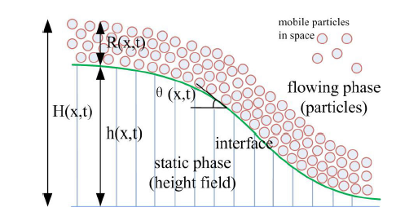
Surface flow [Zhu et al. 2010]
Sand separated into 2 layers
Appearance
Sand appearance – surface layer only
Heap formation – surface layer flows, interior immobile
Surface flowing layer – Discrete Element Method
captures detailed flow
Static layer – height field
Matter transfer between layers
surface flow equations

Slide 18
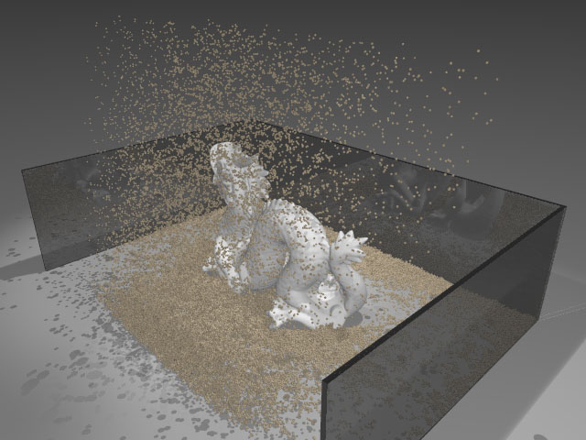
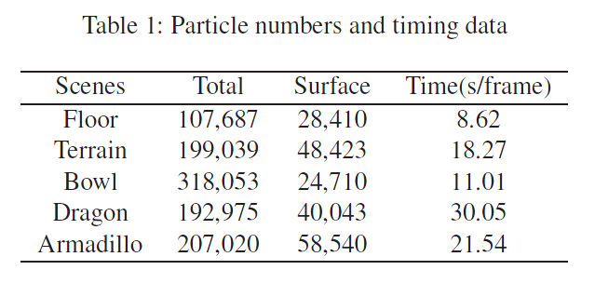
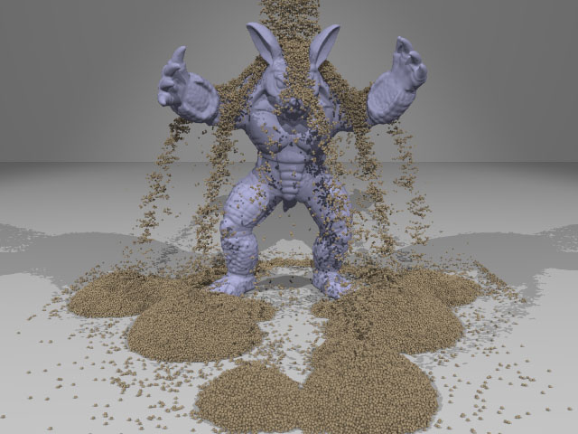
Video
http://vimeo.com/12313312

Slide 19
Approaches
Particle-based
Surface flow
Fluid simulation
Continuum approach

Slide 20
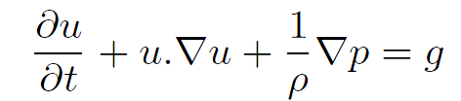
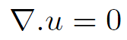
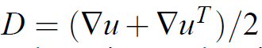
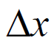
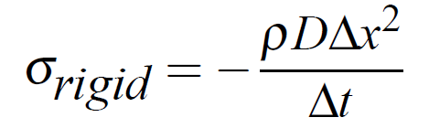
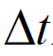
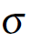
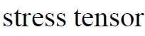
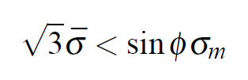
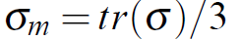
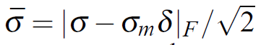
Fluid simulation [Zhu and Bridson 2005]
Adding friction to traditional fluid simulator
Run a typical fluid simulation step
Estimate strain tensor D at each cell assuming rigidity
Calculate
Yield condition
Satisfied – mark cell as rigid
Not satisfied – fluid cell
grid cell width
time-step

Slide 21
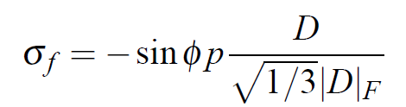
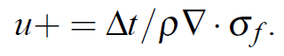
Fluid simulation [Zhu and Bridson 2005]
Rigid cell
Project velocities of connected components of rigid cells onto space of rigid body motions (“Rigid Fluids”)
Fluid cell
Calculate and store
Update velocity

Slide 22
Animating Sand as a Fluid [Zhu and Bridson 2005]
Continuum formulation
Bootstrap a fluid simulator
Fast, but incomplete physical model
Limitations
Incompressibility → cohesive behavior →wet sand

Slide 23
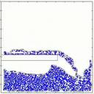
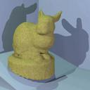
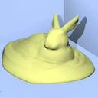
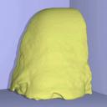
Videos

Slide 24
Approaches
Particle-based
Surface flow
Fluid simulation
Continuum approach

Slide 25
Continuum approach
Treat granular particles as continuous fluid
Avalanches and landslides [Quecedo et al. 2004, Josserand et al. 2004]
Sand and granular material [Narain et al 2010]
Efficient numerical methods
Regular computational domain
User specified resolution for simulation

Slide 26
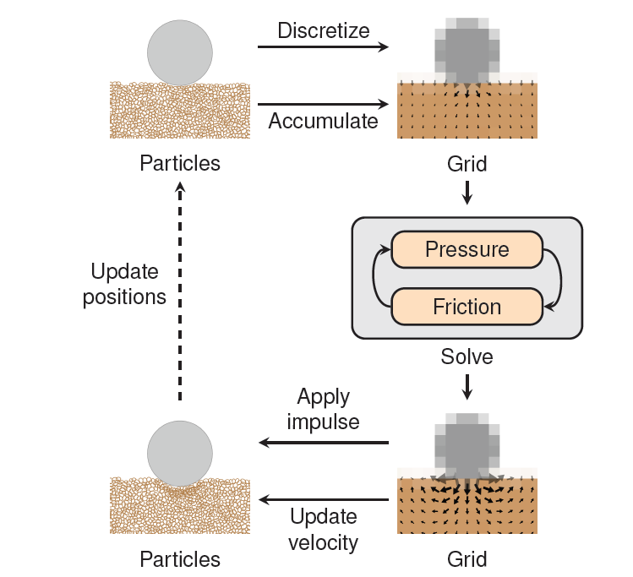
Simulation loop
Particles
Carry mass and momentum
Grid
Compute internal pressure and frictional stresses

Slide 27
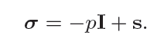


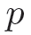
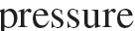
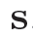
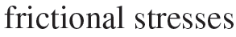
Stress
_{y}
Stress
At equilibrium – matrix is symmetric – 6 degrees of freedom
Pressure for fluids – tr(σ)/ 3
_{z}
_{x}
_{y}
_{z}
_{x}

Slide 28
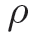
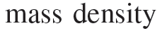
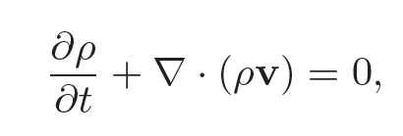
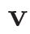
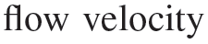
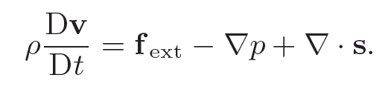
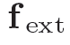
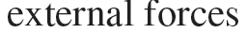
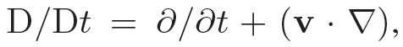
Mass transport
Forces

Slide 29
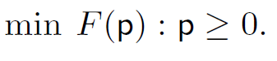
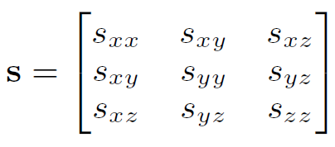
Compute pressure p
Compute friction s

Slide 30
Fluid Model
Variational approach
Assume inelastic collisions
Stress will work so as to minimize total energy of the system
Implicit calculation of stress forces
Assuming only kinetic energy
Can be formulated as a minimization problem
If constraints complementary  LCP

Slide 31
Simulation loop
Particles
Carry mass and momentum
Grid
Compute internal pressure and frictional stresses

Slide 32
Simulation particles
Represented as ellipses
Split
Ensure coverage of grid
Conserve mass, volume
Merge
# of particles

Slide 33
Rendering
Sand rendered as point cloud
Pixar Renderman
Render particles
uniformly sampled distribution over simulation ellipsoid
Reduce cost
Detect regions of high density → avoid sampling in interior

Slide 34
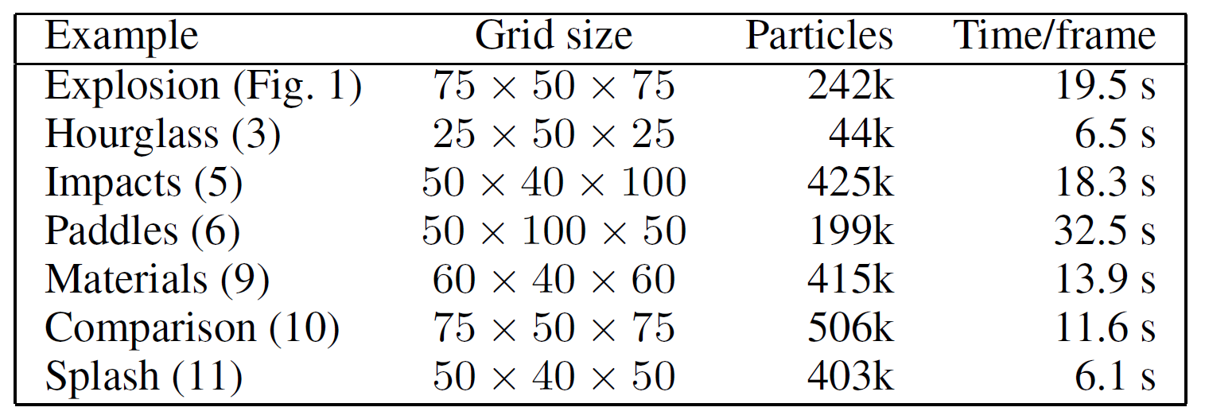
Timings

Slide 35



Videos

Slide 36
References
ALDU´A N, I., TENA, ., AND OTADUY, M. A. 2009. Simulation of high-resolution granular media. In Proc. of Congreso Espan˜ol de Informa´tica Gra´fica.
LUCIANI, A., HABIBI, A., AND MANZOTTI, E. 1995. A multi-scale physical model of granular materials. In Proceedings of Graphics Interface.
ZHU, Y., AND BRIDSON, R. 2005. Animating sand as a fluid. In SIGGRAPH ’05: ACM SIGGRAPH 2005 Papers, ACM, New York, NY, USA, 965–972.
JOSSERAND, C., LAGR´E 458 E, P.-Y., AND LHUILLIER, D. 2004. Stationary shear flows of dense granular materials: a tentative continuum modelling. The European Physical Journal E: Soft Matter and Biological Physics 14 (06), 127–135.
QUECEDO, M., PASTOR, M., HERREROS, M. I., AND MERODO, J. A. F. 2004. Numerical modelling of the propagation of fast landslides using the finite element method. International Journal for Numerical Methods in Engineering 59, 6,
BELL, N., YU, Y., AND MUCHA, P. J. 2005. Particle-based simulation of granular materials. In SCA ’05: Proceedings of the 2005 ACM SIGGRAPH/Eurographics symposium on Computer animation, ACM, New York, NY, USA, 77–86.
Narain R., Golas A., Lin Ming (University of North Carolina at Chapel Hill), Free-Flowing Granular Materials with Two-Way Solid Coupling, SIGGRAPH ASIA 2010.

Slide 37
The End

Slide 38

The Yield surface
Defines when a solid will yield under stress
Condition when sand will become fluid
Mohr – Coulomb yield surface used for granular materials where
Image courtesy: Wikipedia

Slide 39

Adapting constraints
Yield condition
Non-linear – can be approximated as an intersection of linear constraints
Infinity norm
Unilateral incompressibility
Hydrostatic pressure = σ_{m}

Boundary contact
Contact velocity
Frictional forces on tangential velocity
Image courtesy: Wikipedia

Slide 40
Fluid Model
v
Relevant quantities
Velocity
Density
Stress
Modified Navier Stokes equation
Stress in sand
Normal  compressive
Shear  friction
u
σ, ρ
u
v

Slide 41
Fluid Model
Stress maintained at every cell instead of pressure
Sand can be
Rigid  D = 0
D_{ij} = ½(du_{i}/d_{j} + du_{j}/d_{i})
Incompressible Fluid  .u = 0
Loose ( gas-like )

Slide 42
Solving for friction*
Friction reduces velocity
Minimize kinetic energy!
Yield surface restriction
Boundaries
Can we add contact constraints?

Slide 43

Grains
Grid not sufficient for detailed resolution
Particles in Grid
Volume particles *
No surface representation
Mass/Volume?
Ellipsoid/Spherical particles
Cheap (possibly approximate) collision avoidance
Animating Sand as a Fluid

